Slide 1
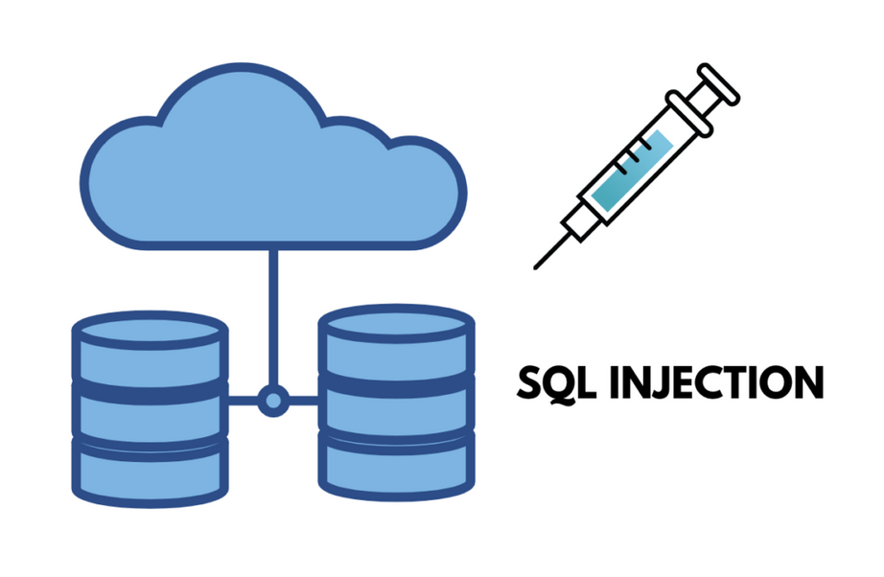
SQL Injection Detection and Prevention Techniques
Presented by: Sarita Sangrez, Amna Ali, Eman Akbar
Department: Cyber Security, FAST NUCES Islamabad

Slide 2
Introduction
SQL Injection remains a top vulnerability (OWASP Top 10).
Occurs due to improper validation of SQL query inputs.
Traditional defenses (input validation, prepared statements, WAFs) struggle against obfuscated and zero-day attacks.
Recent trend: use of Machine Learning and Deep Learning for intelligent detection.
Our work evaluates Random Forest + secure logging + GUI-based detection system.

Slide 3
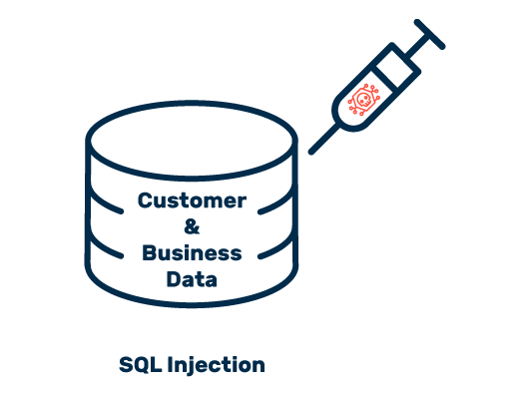
Problem Statement & Research Gap
SQLi attacks evolve rapidly, so traditional signature-based detection fails.
Deep learning models are accurate but not interpretable and require high computational power.
Existing ML systems lack:
Real-time detection
Explainability (SHAP, LIME)
Encrypted logs
Demonstration of both detection and prevention
Goal: Build a practical, interpretable, deployable SQLi detection and prevention system.

Slide 4
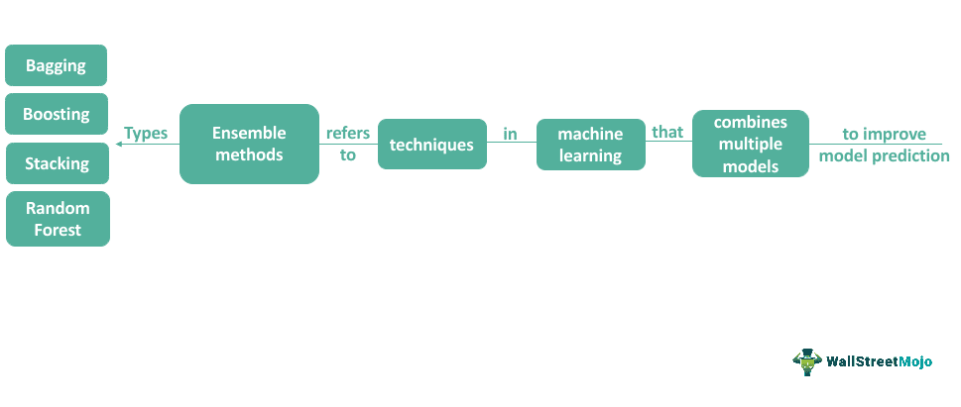
Literature Review (Ensemble & Boosting Models)
Hussain et al.: Random Forest, XGBoost, AdaBoost, etc.
Integrated SHAP & LIME for interpretability.
Random Forest showed highest accuracy and transparency.
Limitation: dataset small, not diverse; no automated prevention.
Our research extends this by using a public Kaggle dataset + real GUI + prevention module.

Slide 5
Literature Review (Deep Learning & Semantic Models)
Hassan et al.: Deep Neural Networks with 19 handcrafted features gave 98% accuracy.
Strong accuracy but lacked scalability and real-world traffic testing.
synBERT: transformer-based semantic detection for strong zero-day detection.
Overall trend: hybrid models and contextual understanding.
Gap: low interpretability and high complexity for deployment.

Slide 6
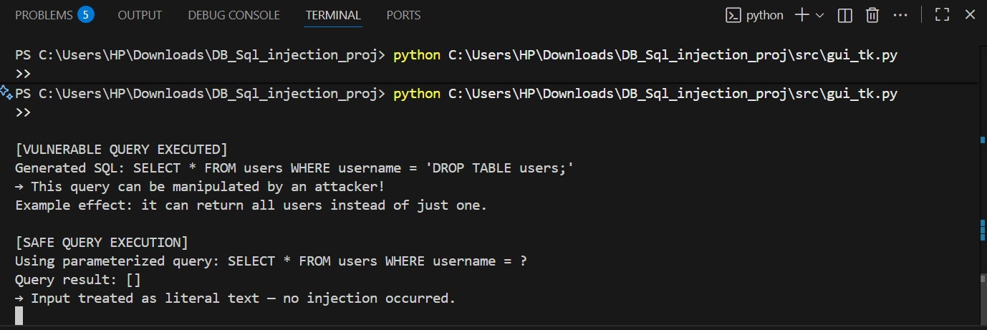
Methodology / Proposed Framework
Our framework includes:
Data Preprocessing
Null removal, text normalization, tokenization.
Hybrid Feature Extraction
TF-IDF vectorization & custom handcrafted features.
Model Training (Random Forest)
Stored as rf_model.pkl.
Explainability Layer
Uses SHAP.
GUI Integration (Tkinter)
Real-time predictions and probability scores.
Secure Logging
AES/Fernet-encrypted logs.
Prevention Demo
Safe vs unsafe queries using parameterized statements.

Slide 7
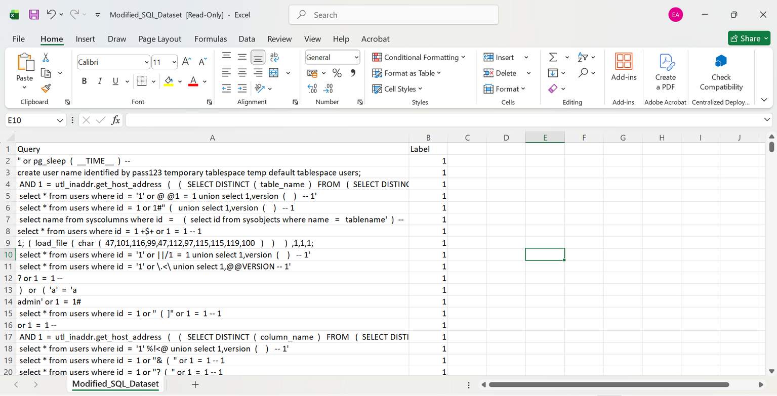
Dataset Description
Public dataset from Kaggle containing:
Normal SQL queries
Malicious SQL injection attempts
Features include:
Query length
Keyword density
Special characters
Digit/operator ratios
TF-IDF tokens
80% training / 20% testing split
Balanced dataset to avoid bias.

Slide 8
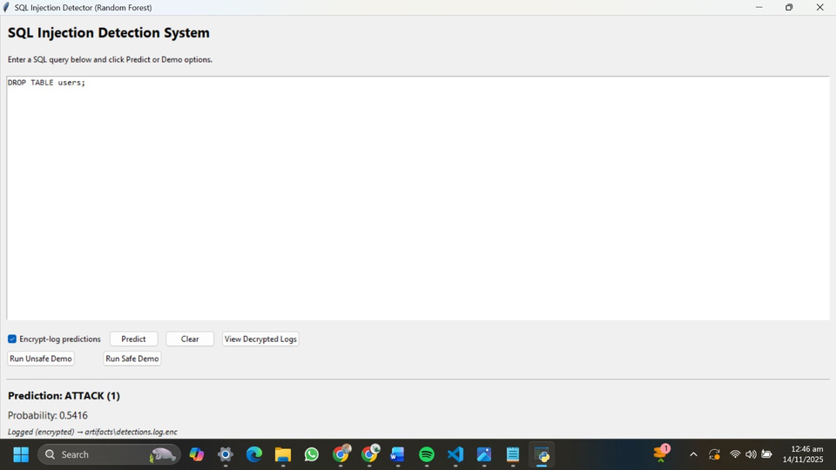
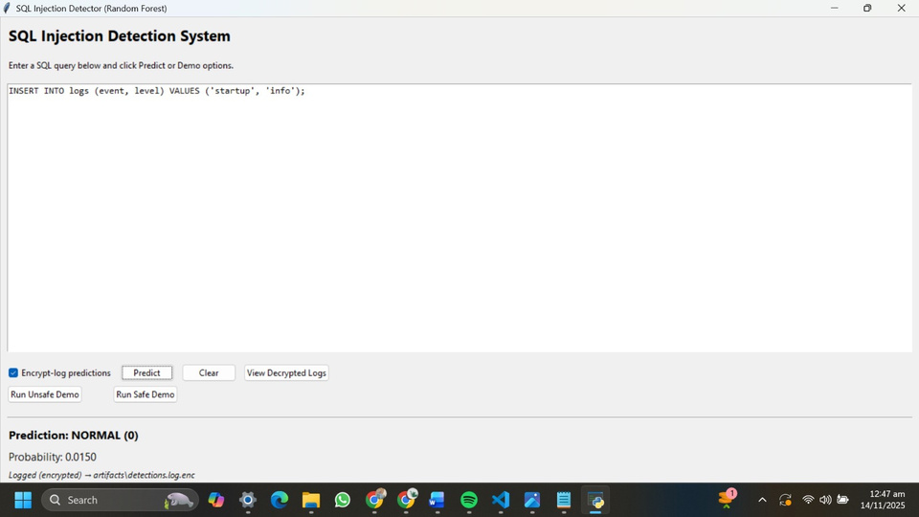
Results & Evaluation
Random Forest achieved:
AUC = 0.9994
High accuracy, precision, and recall
Very low false positives
Visual outputs include:
Confusion matrix
ROC curve
Feature importance ranking (top 20)
GUI tests show successful detection of normal and malicious queries.
Secure logs decrypt correctly and maintain integrity.

Slide 9
Comparison with Existing Techniques
Compared to:
Logistic Regression & SVM : lower accuracy for complex SQL patterns
Deep Learning Models : higher accuracy but expensive & less interpretable
Boosting Models : powerful but require heavy tuning
Random Forest Pros:
Balanced accuracy and interpretability
Fast inference
Works well with hybrid features
Easy deployment
Practical Advantages:
Real-time GUI
Preventive demonstration
Encrypted logs (rare in research prototypes)

Slide 10
Conclusion & Future Work
Successfully implemented an effective SQLi detection and prevention framework.
Random Forest performed exceptionally well with near-perfect AUC.
System includes explainability (SHAP), GUI, and secure encrypted logging.
Limitations: dataset diversity, scalability for enterprise-level traffic.
Future Work:
Include real-time web traffic streams
Hybrid ensemble & deep learning models
Autonomous blocking of attacks
Cloud deployment with API integration

Slide 11
Thank You!
Any Questions?

